Slide 1
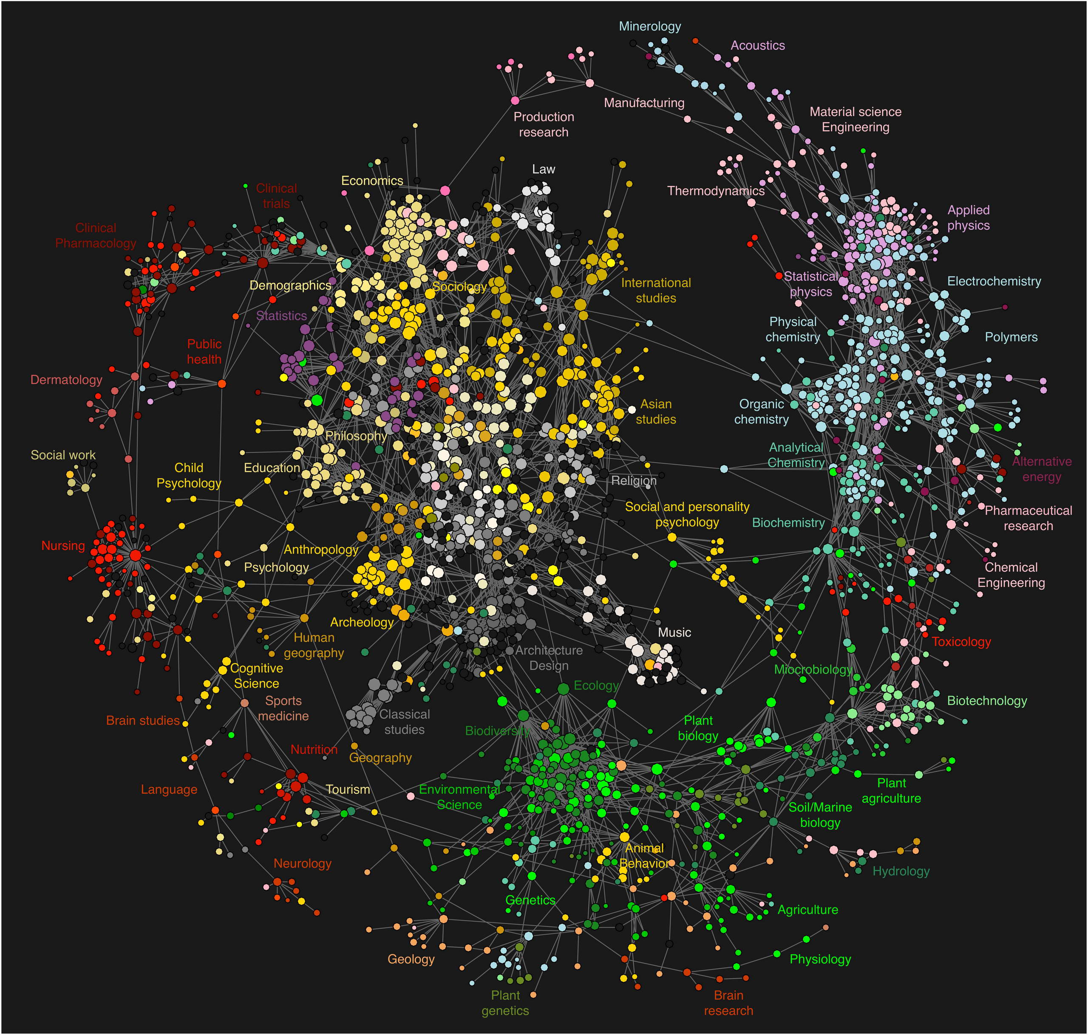
MIE 1624 Project Group 9
Xiafei Luo
Xihao Liu
Yifan Shao
Yichun Cai
Zhihao Zhang
Wenqing Wang

Slide 2
Overview
1624 course curriculum design
M.D.S.A. and M.B.A.I program design
EdTech Startup

Slide 3
1624 course curriculum design

Slide 4
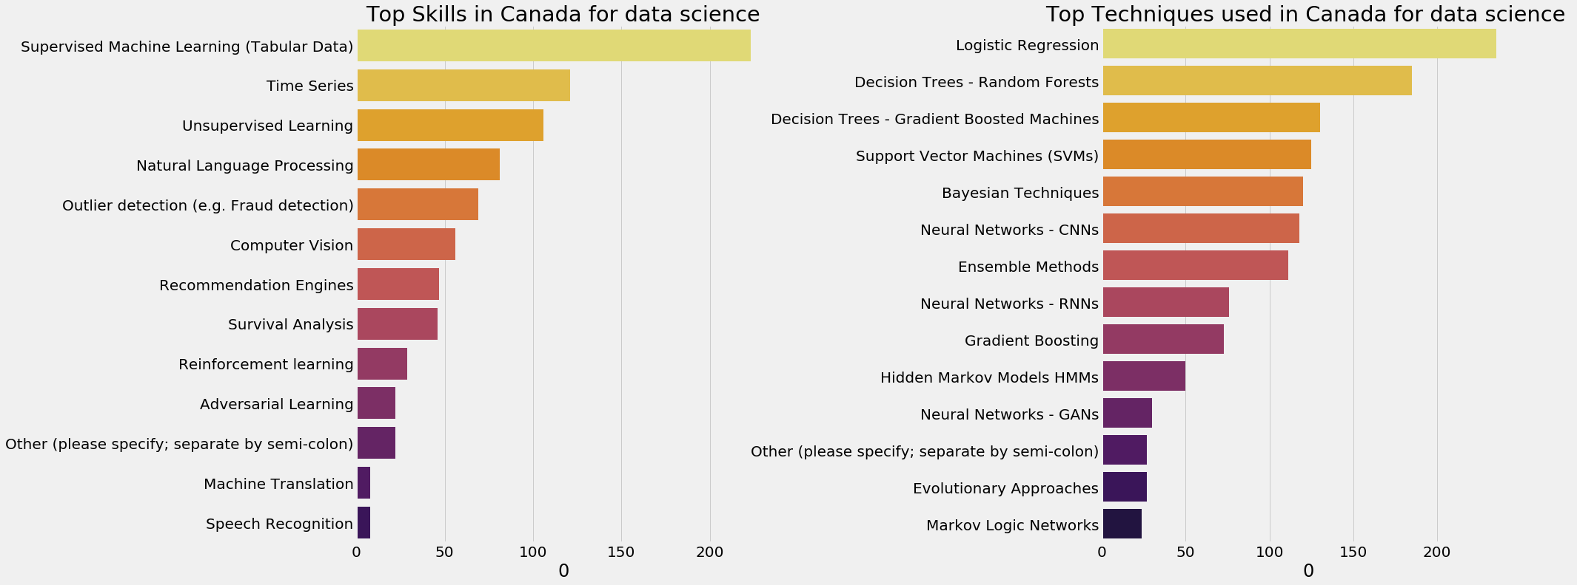
Top Skills from survey
Notes:
Localized data

Slide 5
Week 1
Introduction
Week 2
Tools
Week 4-10
Machine Leaning Skills
Week 9
Unsupervised Learning
Week 10
Neural Networks
Week 3-7
Supervised Learning
Week 5
Decision Tree
Random Forest
Week 6
Decision Tree
Gradient Boost
Week 7
Other SL
Week 4
Logistic Regression
Week 8
Time Series
Week 3
Math Skills
Week 11
Review
Lecture
Notes:
MIE 1624 Lecture

Slide 6
Top Tools

Slide 7
Tutorial
SQL
Basic
Matplot & Seaborn
Scikit-learn
R
Python
Pandas & Numpy
Notebook&
Tensorflow
Tutorial
Notes:
Tutorial

Slide 8
M.D.S.A. and M.B.A.I program design

Slide 9
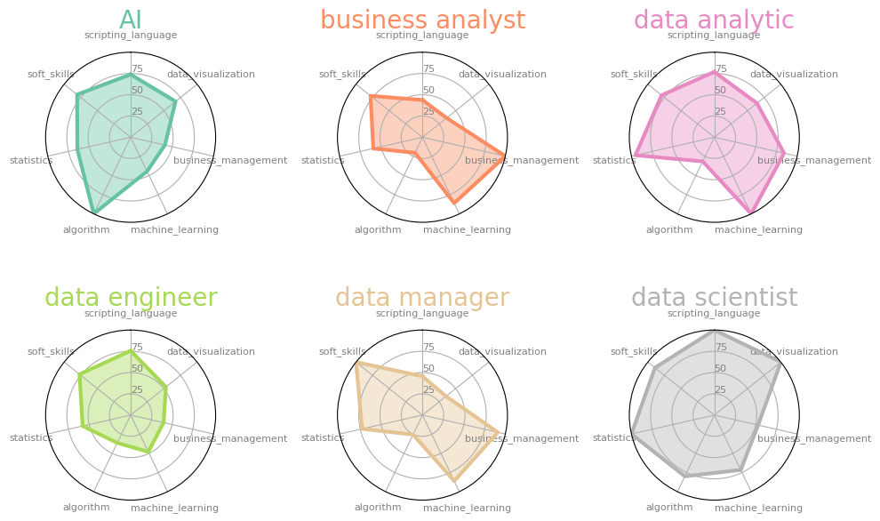

Slide 10
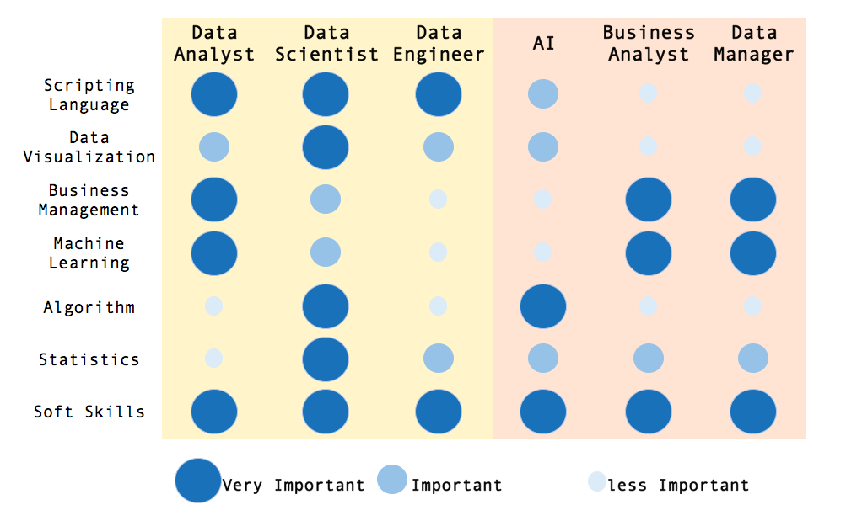
Job Skills
Notes:
Now we use a different way to present the graph in the last slide. We divide the score from the spider chart into 3 levels, very important, important and less important depending on the value of the score of the skill. Then we get this. For example, for data analyst, scripting language, business management and machine learning, and soft skills are important.

Slide 11
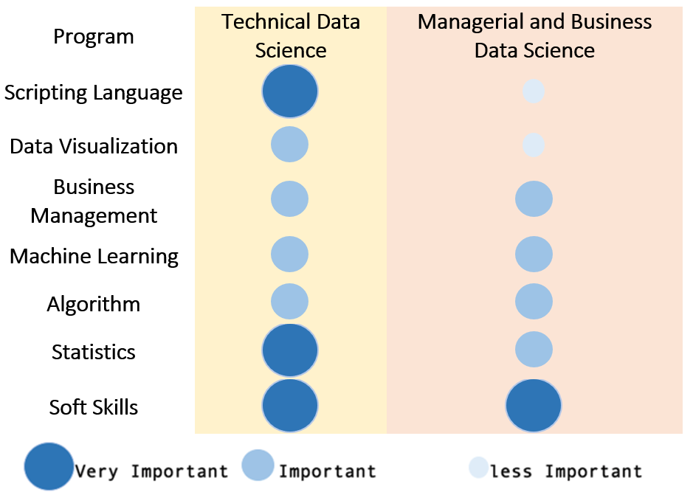
Courses Skills
Notes:
Now we combine data analyst, data scientist and data engineer into technical data science group it correspond to M.D.S.A, and combine AI, business analyst and data manager into managerial and business data science group, it corresponds to M.B.A.I. This will help us decide how many courses to assign into each skill category.

Slide 12
M.D.S.A.
Semester 1
Semester 2
Semester 3
Semester 4
Introduction of Data Science
Cloud Computing
1 required course in
Capstone Project
Data Wrangling
Statistics
1 required course in data visualization
Business Communication & Analytics
1 required course in machine learning
1 required course in Algorithm
1 free elective course
business & management
Notes:
The Master of Data Science and Analytics program is designed to be 16 month, 4 semester program for full time students. It will have 5 required course and 5 electives Here’s recommended course path for the students.. Students will use their first three semesters to learn technical and soft skills that are necessary to become a data scientist and data analyst, then in the last semester the students will put what their learned into practice by participating the capstone project.

Slide 13
M.B.A.I.
Semester 1
Semester 2
Semester 3
Semester 4
Introduction to Data Science
Foundations of AI
1 required Statistic course
Knowledge, Visualization and Communication
Business Communications & Analytics Consulting
1 required course in machine learning
1 free elective course
1 free elective course
Capstone Project
1 required course in business management
1 required Algorithm course
Notes:
Master of Management and Business in Analytics and A.I. is a 16 month, 4 semester full time program, the students are required to finish 4 required core courses and 6 elective courses and a capstone project to graduate. Here’s proposed course sequence for the students. The difference from M.D.S.A is that student will take less technical courses and instead they take more business management course and soft skill related courses.

Slide 14
EdTech Startup

Slide 15
EdTech Startup
Users
People who are interested in data science
People who want to improve their skills in data science area
Potential employers and employees in data science area
Questions
How to help people to know data science and improve their technical skills?
How to connect employers with our users？

Slide 16
EdTech Startup
Solution 1
Provide online courses about popular skills for users
Provide practice sets and discussion board

Slide 17
EdTech Startup
Keyword | Class 0 | Class 1 | Class 2
Python
R
SQL
Jupyter notebooks
TensorFlow
C/C++
MATLAB/Octave
Unix shell / awk
Amazon Web services
Java
NoSQL
According to K-Means analysis, we will emphasize skills in higher class.
People will be more interested in skills which are in class 2.
Skills Classification Table

Slide 18
EdTech Startup
Solution 2
Invite companies to provide open projects with realistic datasets on our website
Users can upload resumes directly on our website, and potential employers can easily check their works here.
Percentage of Data Science Programs with Project

Slide 19
Question?

